Slide 1
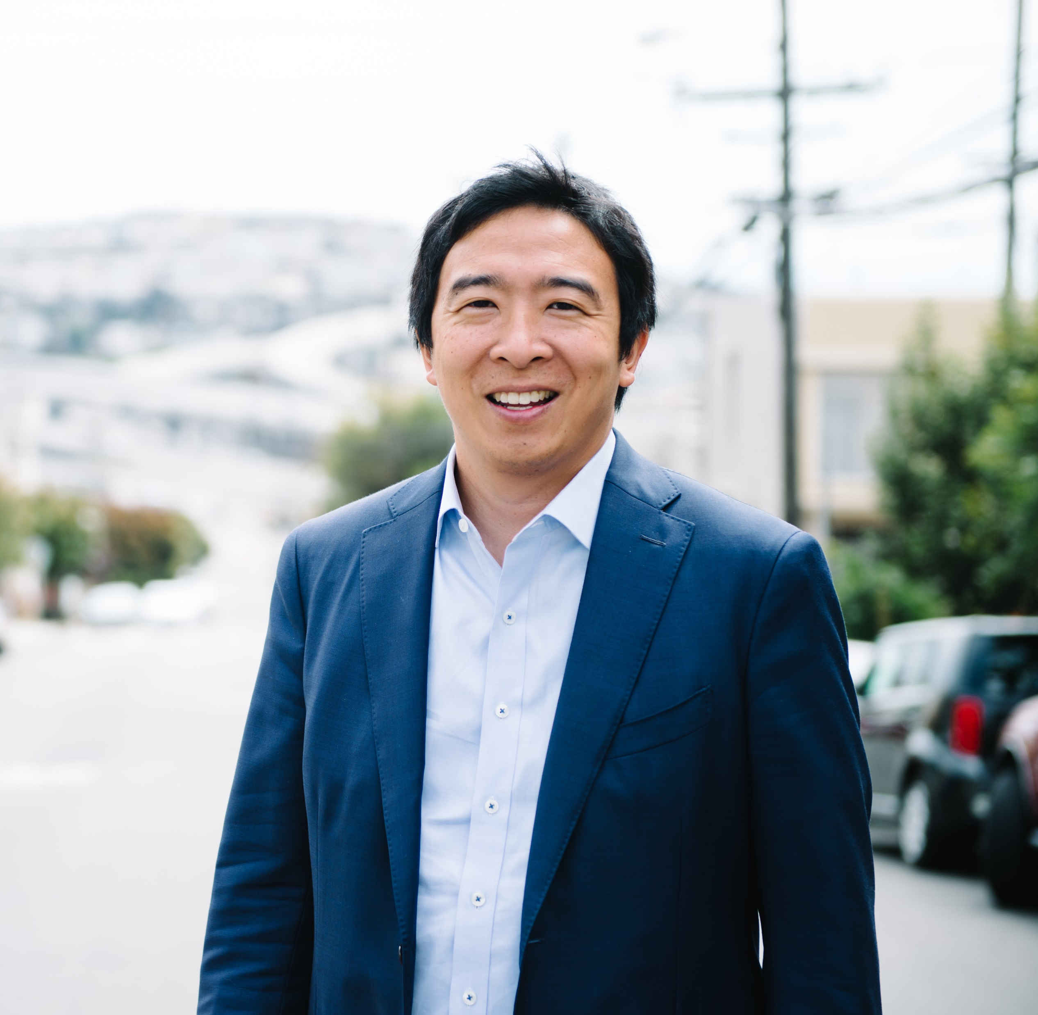
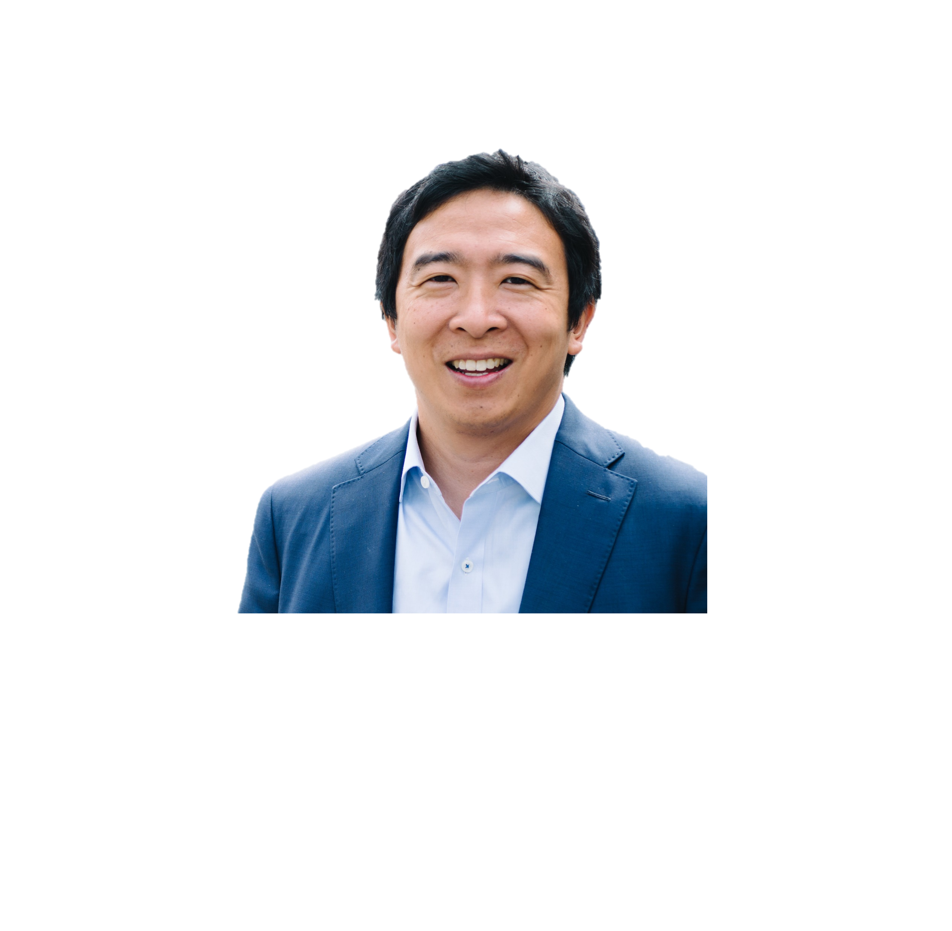

“We know that women do more unrecognized and uncompensated work in our society. It will not change unless we change it, and I say that’s just what we do.”
Interviews
● Andrew on The View ● Andrew Talks UBI on the Breakfast Club ●
● Why UBI Empowers Women, Paget Kagy ● A Conversation with Presidential Candidate Andrew Yang, Laurie Ruettimann ●

